Slide 1


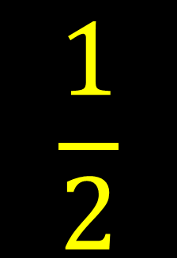






My Algebra – Solving Equations Interactive Notebook
$$×$$
$$\frac{1}{2}$$
$$÷$$
$$+$$
$$−$$
$$\frac{3}{5}$$
$$7$$
Name
Class
Teacher
Term 2 Semester 1
$$5^{2}$$
$$\sqrt{9}$$

Slide 2
Contents
Glossary or Formula Page
Page
Date
Description
2

Slide 3
Tasks
24
7
30
Essential Question
Questions
Notes
Summary
6

Slide 4
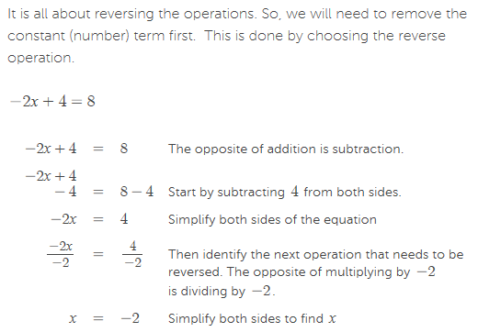
24
7
30
Date
Solving Linear Equations
EQ – Algebraic Technique?
This means using the "do the same to both sides" method, to isolate the x. That is, get the x on its own.

Slide 5
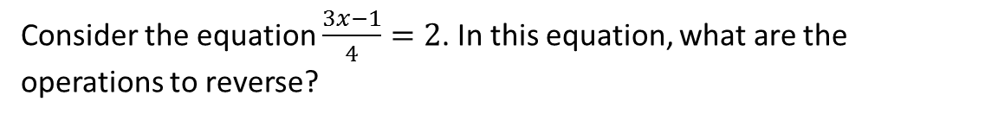
24
7
30
Date
Solving Linear Equations
EQ – Algebraic Technique?
This means using the "do the same to both sides" method, to isolate the x. That is, get the x on its own.
You can think of solving an equation as reversing a series of operations to find the value of the unknown. In three step equations, these operations may involve a combination of addition, subtraction, multiplication and division to make the pronumeral the subject of the equation (in other words get it to one side of the equation by itself).
Consider the equation $\frac{3x−1}{4}=2$. In this equation, what are the operations to reverse?
Well, x has been:
1. Multiplied by 3
2. Then 1 has been subtracted
3. Then the result has been divided by 4
We would need to reverse each of these three operations to solve for the value of x.
Remember that whatever operation we do to one side we must do to the other.

Slide 6
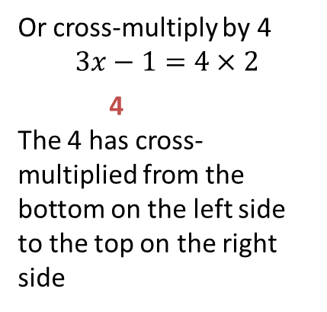
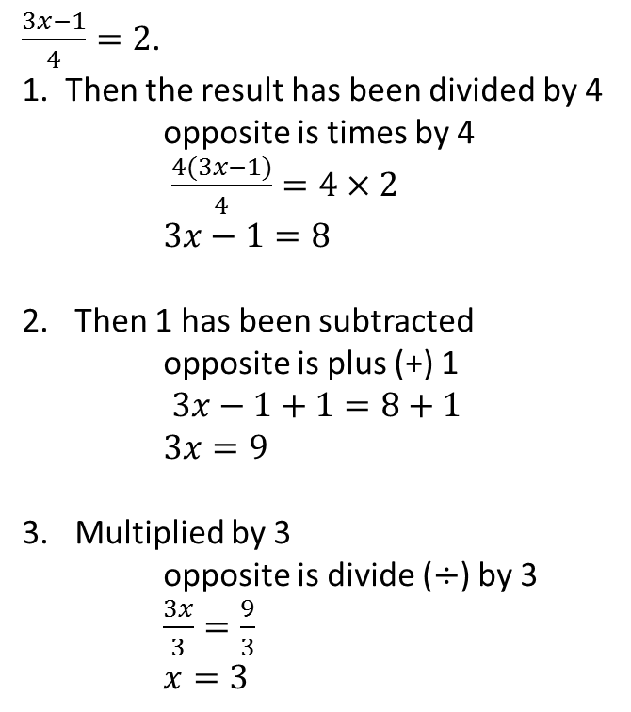
24
7
30
Date
Solving Linear Equations
EQ – Algebraic Technique?
This means using the "do the same to both sides" method, to isolate the x. That is, get the x on its own.
$\frac{3x−1}{4}=2$.
1. Then the result has been divided by 4 opposite is times by 4
$\frac{4(3x−1)}{4}=4×2$ $3x−1=8$
Then 1 has been subtracted opposite is plus (+) 1
$3x−1+1=8+1$
$3x=9$
Multiplied by 3
opposite is divide ($÷$) by 3
$\frac{3x}{3}=\frac{9}{3}$
$x=3$
Or cross-multiply by 4
$$3x−1=4×2$$
4
The 4 has cross-multiplied from the bottom on the left side to the top on the right side

Slide 7
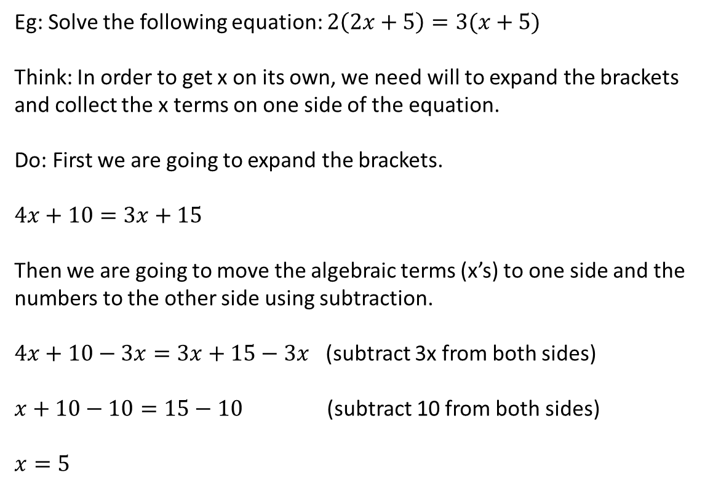
24
7
30
Date
Solving Linear Equations
EQ – Algebraic Technique?
Eg: Solve the following equation: $2\left(2x+5\right)=3(x+5)$
Think: In order to get x on its own, we need will to expand the brackets and collect the x terms on one side of the equation.
Do: First we are going to expand the brackets.
$$4x+10=3x+15$$
Then we are going to move the algebraic terms (x’s) to one side and the numbers to the other side using subtraction.
$4x+10−3x=3x+15−3x$ (subtract 3x from both sides)
$x+10−10=15−10$ (subtract 10 from both sides)
$$x=5$$
This means using the "do the same to both sides" method, to isolate the x. That is, get the x on its own.

Slide 8
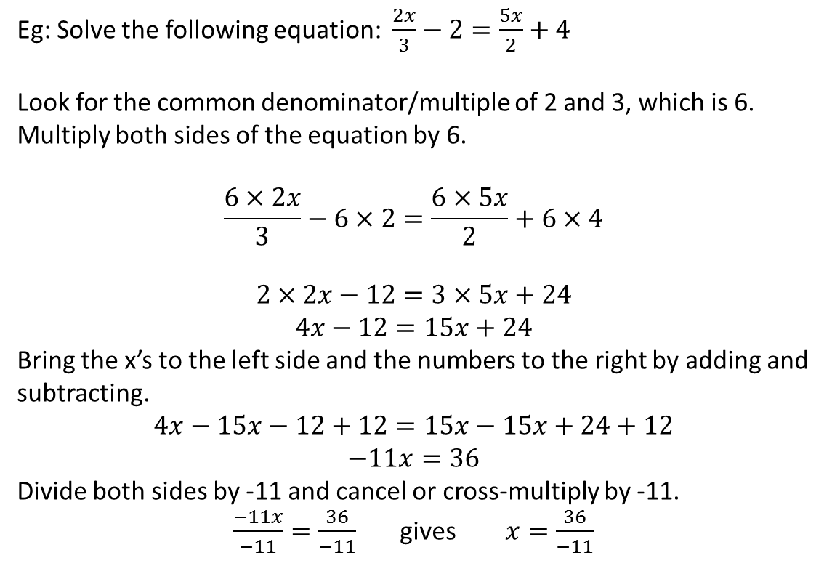
24
7
30
Date
Solving Linear Equations
EQ – Algebraic Technique?
Eg: Solve the following equation: $\frac{2x}{3}−2=\frac{5x}{2}+4$
Look for the common denominator/multiple of 2 and 3, which is 6. Multiply both sides of the equation by 6.
$$\frac{6×2x}{3}−6×2=\frac{6×5x}{2}+6×4$$
$$2×2x−12=3×5x+24$$
$$4x−12=15x+24$$ Bring the x’s to the left side and the numbers to the right by adding and subtracting. $$4x−15x−12+12=15x−15x+24+12$$
$$−11x=36$$
Divide both sides by -11 and cancel or cross-multiply by -11.
$\frac{−11x}{−11}=\frac{36}{−11}$ gives $x=\frac{36}{−11}$
This means using the "do the same to both sides" method, to isolate the x. That is, get the x on its own.
2 cancels with 6
3 cancels with 6

Slide 9
Exercises
Exercise 7.1 from Dwyer
Plus there is some work on Mathspace to do
yr 10 Solving Linear Equations
All to be done with a smile on your faces.

Slide 10
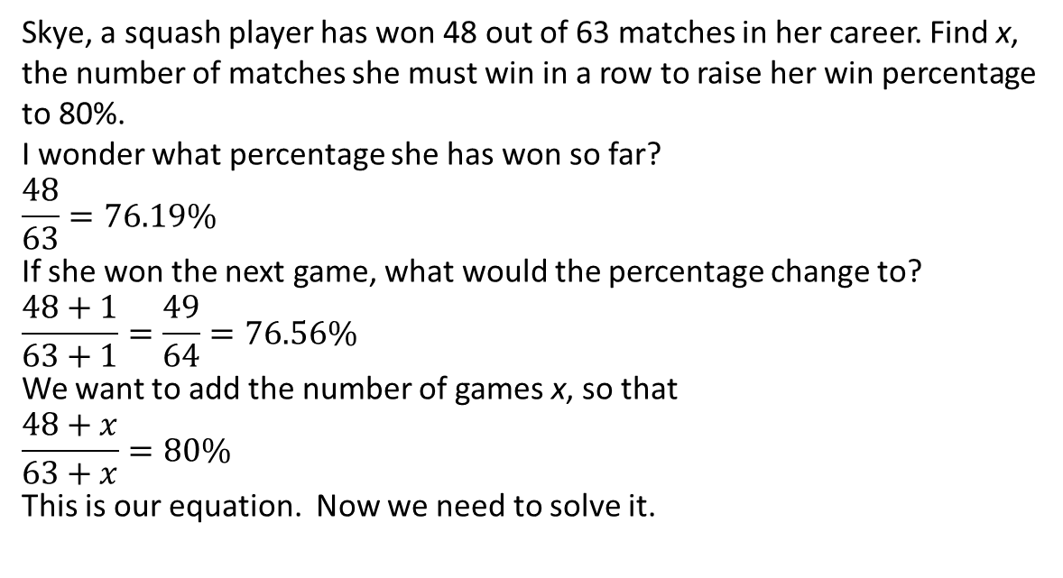
24
7
30
Date
Solving Linear Equations
EQ – Algebraic Technique for worded problems?
Skye, a squash player has won 48 out of 63 matches in her career. Find x, the number of matches she must win in a row to raise her win percentage to 80%.
I wonder what percentage she has won so far?
$$\frac{48}{63}=76.19\%$$
If she won the next game, what would the percentage change to?
$$\frac{48+1}{63+1}=\frac{49}{64}=76.56\%$$
We want to add the number of games x, so that
$$\frac{48+x}{63+x}=80\%$$
This is our equation. Now we need to solve it.
This means using the "do the same to both sides" method, to isolate the x. That is, get the x on its own.

Slide 11
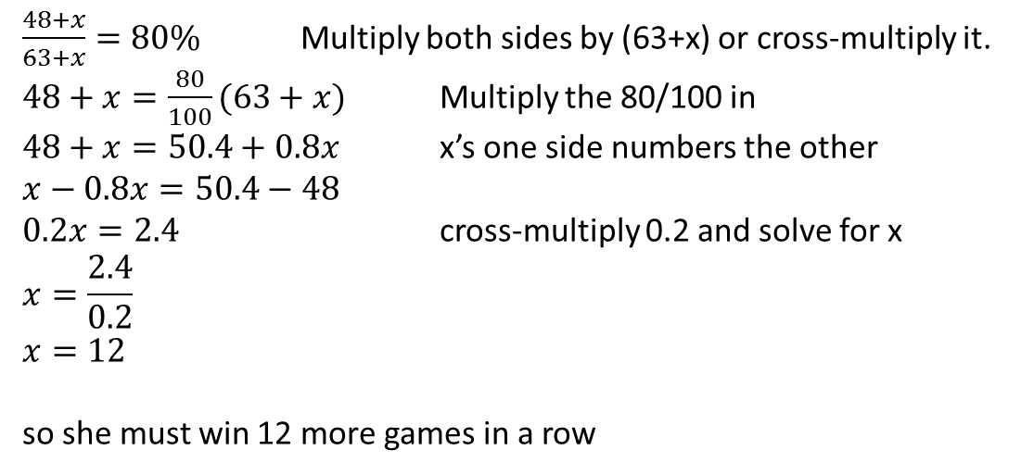
24
7
30
Date
Solving Linear Equations
EQ – Algebraic Technique for worded problems?
This means using the "do the same to both sides" method, to isolate the x. That is, get the x on its own.
$\frac{48+x}{63+x}=80\%$ Multiply both sides by (63+x) or cross-multiply it.
$48+x=\frac{80}{100}(63+x)$ Multiply the 80/100 in
$48+x=50.4+0.8x$ x’s one side numbers the other
$$x−0.8x=50.4−48$$
$0.2x=2.4$ cross-multiply 0.2 and solve for x
$$x=\frac{2.4}{0.2}$$
$$x=12$$
so she must win 12 more games in a row

Slide 12
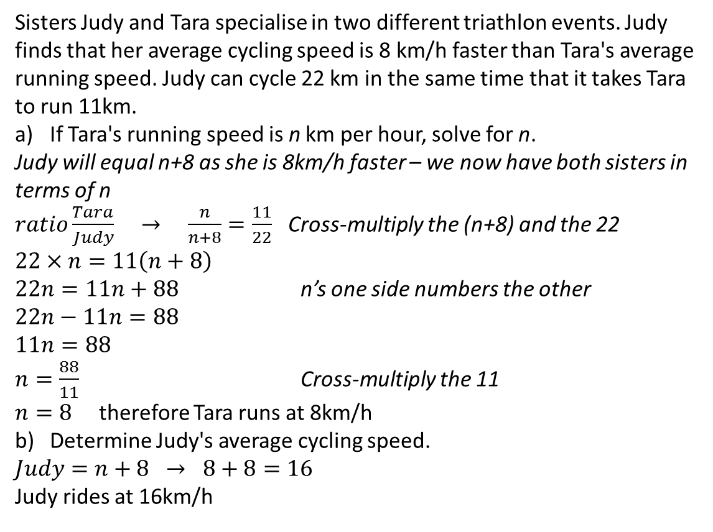
24
7
30
Date
Solving Linear Equations
EQ – Algebraic Technique for worded problems?
Sisters Judy and Tara specialise in two different triathlon events. Judy finds that her average cycling speed is 8 km/h faster than Tara's average running speed. Judy can cycle 22 km in the same time that it takes Tara to run 11km.
If Tara's running speed is n km per hour, solve for n.
Judy will equal n+8 as she is 8km/h faster – we now have both sisters in terms of n
$ratio\frac{Tara}{Judy} → \frac{n}{n+8}=\frac{11}{22}$ Cross-multiply the (n+8) and the 22
$$22×n=11\left(n+8\right)$$
$22n=11n+88$ n’s one side numbers the other
$$22n−11n=88$$
$$11n=88$$
$n=\frac{88}{11}$ Cross-multiply the 11
$n=8$ therefore Tara runs at 8km/h
Determine Judy's average cycling speed.
$$Judy=n+8 → 8+8=16$$
Judy rides at 16km/h
This means using the "do the same to both sides" method, to isolate the x. That is, get the x on its own.

Slide 13
Exercises
Exercise 7.2 & 7.3 from Dwyer
Plus there is some work on Mathspace to do
yr 10 Problem Solving with Linear Equations
All to be done with a smile on your faces.

Slide 14
Notes Review
24, 7 ,30
Date
Title
Essential question
Notes complete
Notes complete with colour and diagrams
Questions completed
Contents page filed in
Formula page filled in

Slide 15
Homework
Review your notes and write a summary answering the essential question.

